Slide 1
Chapter 2
Getting Started
Sun-Yuan Hsieh
謝孫源 教授
成功大學資訊工程學系

Slide 2
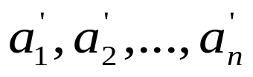
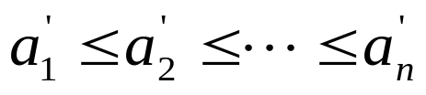


2.1 Insertion sort
Example: Sorting problem
  Input: A sequence of n numbers ⟨a₁, a₂,…, a_{n}⟩
  Output: A permutation ⟨ ⟩ of the input sequence such that .
The number that we wish to sort are known as the keys.

Slide 3
Pseudocode
Insertion sort
  Insertion-sort(A)
  for j ← 2 to length[A]
  do key ← A[j]
  *Insert A[j] into the sorted sequence A[1,…, j – 1]
  i ← j – 1
  while i > 0 and A[i] > key
  do A[i + 1] ← A[i]
  i ← i – 1
  A[i + 1] ← key

Slide 4
The operation of Insertion-Sort
1 | 2 | 3 | 4 | 5 | 6
5 | 2 | 4 | 6 | 1 | 3
1 | 2 | 3 | 4 | 5 | 6
2 | 5 | 4 | 6 | 1 | 3
(a)
(b)
1 | 2 | 3 | 4 | 5 | 6
2 | 4 | 5 | 6 | 1 | 3
1 | 2 | 3 | 4 | 5 | 6
2 | 4 | 5 | 6 | 1 | 3
(c)
(d)
1 | 2 | 3 | 4 | 5 | 6
1 | 2 | 4 | 5 | 6 | 3
1 | 2 | 3 | 4 | 5 | 6
1 | 2 | 3 | 4 | 5 | 6
(e)
(f)

Slide 5
Sorted in place:
  The numbers are rearranged within the array A, with at most a constant number of them sorted outside the array at any time.
Loop invariant:
  At the start of each iteration of the for loop of line 1-8, the subarray A[1,…, j – 1] consists of the elements originally in A[1,…, j – 1] but in sorted order.

Slide 6
2.2 Analyzing algorithms
Analyzing an algorithm has come to mean predicting the resources that the algorithm requires.
  Resources: memory, communication, bandwidth, logic gate, time.
  Assumption: one processor, RAM
  constant-time instruction: arithmetic (add, subtract, multiply, divide, remainder, floor, ceiling); data movement (load, store, copy); control (conditional and unconditional bramch, subroutine call and return)
  Date type: integer and floating point
  Limit on the size of each word of data

Slide 7
2.2 Analyzing algorithms
The best notion for input size depends on the problem being studied.
The running time of an algorithm on a particular input is the number of primitive operations or “steps” executed. It is convenient to define the notion of step so that it is as machine-independent as possible.

Slide 8


Analysis of insertion sort
cost
cost
  Insertion-sort(A)
  for j ← 2 to length[A]
  do key ← A[j]
  *Insert A[j] into the sorted
  sequence A[1,…, j – 1]
  i ← j – 1
  while i > 0 and A[i] > key
  do A[i + 1] ← A[i]
  i ← i – 1
  A[i + 1] ← key
t_{j}: the number of times the while loop test in line 5 is executed for the value of j.
c₁
n
c₂
n – 1
0
c₄
n – 1
c₅
c₆
c₇
c₈
n – 1

Slide 9


Analysis of insertion sort
The running time
T(n) = c₁n + c₂(n – 1) + c₄(n – 1) + c₅ + c₆
+ c₇ + c₈(n – 1)
t_{j} = 1, for j = 2, 3,…, n: Linear function on n
T(n) = c₁n + c₂(n – 1) + c₄(n – 1) + c₅(n – 1) + c₈(n – 1)
= (c₁ + c₂ + c₄ + c₅ + c₈)n – (c₂ + c₄ + c₅ + c₈)

Slide 10
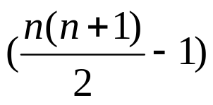
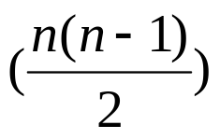
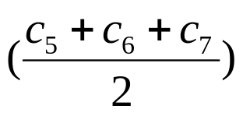
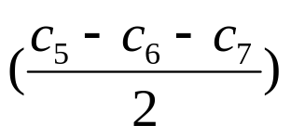
Analysis of insertion sort
t_{j} = j, for j = 2, 3,…, n: Quadratic function on n
T(n) = c₁n + c₂(n – 1) + c₄(n – 1) + c₅
+ c₆ + c₇ + c₈(n – 1)
= n² – (c₁ + c₂ + c₄ + + c₈)n
– (c₂ + c₄ + c₅ + c₈)

Slide 11
Worst-case and average-case analysis
Usually, we concentrate on finding only on the worst-case running time.
Reason:
  It is an upper bound on the running time.
  The worst case occurs fair often.
  The average case is often as bad as the worst case. For example, the insertion sort. Again, quadratic function.

Slide 12
Order of growth
In some particular cases, we shall be interested in average-case, or expect running time of an algorithm.
It is the rate of growth, or order of growth, of the running time that really interests us.

Slide 13


2.3 Designing algorithms
There are many ways to design algorithms:
  Incremental approach: insertion sort
  Divide-and-conquer: merge sort
    recursive:
      divide
      conquer
      combine

Slide 14
Pseudocode
Merge sort
  Merge(A, p, q, r)
  n₁ ← q – p + 1
  n₂ ← r – q
  create array L[1,…, n₁ + 1] and R[1,…, n₂ + 1]
  for i ← 1 to n₁
  do L[i] ← A[p + i – 1]
  for j ← 1 to n₂
  do R[j] ← A[q + j]
  L[n₁ + 1] ← ∞
  R[n₂ + 1] ← ∞

Slide 15
Pseudocode
  i ← 1
  j ← 1
  for k ← p to r
  do if L[i] ≤ R[j]
  then A[k] ← L[i]
  i ← i + 1
  else A[k] ← R[j]
  j ← j + 1

Slide 16
The operation of lines 10-17
 | 8 | 9 | 10 | 11 | 12 | 13 | 14 | 15 | 16 | 17
A | … | 2 | 4 | 5 | 7 | 1 | 2 | 3 | 6 | …
 |  | k
 | 1 | 2 | 3 | 4 | 5
L | 2 | 4 | 5 | 7 | ∞
 | i
 | 1 | 2 | 3 | 4 | 5
R | 1 | 2 | 3 | 6 | ∞
 | j
(a)

Slide 17
The operation of lines 10-17
 | 8 | 9 | 10 | 11 | 12 | 13 | 14 | 15 | 16 | 17
A | … | 1 | 4 | 5 | 7 | 1 | 2 | 3 | 6 | …
 |  |  | k
 | 1 | 2 | 3 | 4 | 5
L | 2 | 4 | 5 | 7 | ∞
 | i
 | 1 | 2 | 3 | 4 | 5
R | 1 | 2 | 3 | 6 | ∞
 |  | j
(b)

Slide 18
The operation of lines 10-17
 | 8 | 9 | 10 | 11 | 12 | 13 | 14 | 15 | 16 | 17
A | … | 1 | 2 | 5 | 7 | 1 | 2 | 3 | 6 | …
 |  |  |  | k
 | 1 | 2 | 3 | 4 | 5
L | 2 | 4 | 5 | 7 | ∞
 |  | i
 | 1 | 2 | 3 | 4 | 5
R | 1 | 2 | 3 | 6 | ∞
 |  | j
(c)

Slide 19
The operation of lines 10-17
 | 8 | 9 | 10 | 11 | 12 | 13 | 14 | 15 | 16 | 17
A | … | 1 | 2 | 2 | 7 | 1 | 2 | 3 | 6 | …
 |  |  |  |  | k
 | 1 | 2 | 3 | 4 | 5
L | 2 | 4 | 5 | 7 | ∞
 |  | i
 | 1 | 2 | 3 | 4 | 5
R | 1 | 2 | 3 | 6 | ∞
 |  |  | j
(d)

Slide 20
The operation of lines 10-17
 | 8 | 9 | 10 | 11 | 12 | 13 | 14 | 15 | 16 | 17
A | … | 1 | 2 | 2 | 3 | 1 | 2 | 3 | 6 | …
 |  |  |  |  |  | k
 | 1 | 2 | 3 | 4 | 5
L | 2 | 4 | 5 | 7 | ∞
 |  | i
 | 1 | 2 | 3 | 4 | 5
R | 1 | 2 | 3 | 6 | ∞
 |  |  |  | j
(e)

Slide 21
The operation of lines 10-17
 | 8 | 9 | 10 | 11 | 12 | 13 | 14 | 15 | 16 | 17
A | … | 1 | 2 | 2 | 3 | 4 | 2 | 3 | 6 | …
 |  |  |  |  |  |  | k
 | 1 | 2 | 3 | 4 | 5
L | 2 | 4 | 5 | 7 | ∞
 |  |  | i
 | 1 | 2 | 3 | 4 | 5
R | 1 | 2 | 3 | 6 | ∞
 |  |  |  | j
(f)

Slide 22
The operation of lines 10-17
 | 8 | 9 | 10 | 11 | 12 | 13 | 14 | 15 | 16 | 17
A | … | 1 | 2 | 2 | 3 | 4 | 5 | 3 | 6 | …
 |  |  |  |  |  |  |  | k
 | 1 | 2 | 3 | 4 | 5
L | 2 | 4 | 5 | 7 | ∞
 |  |  |  | i
 | 1 | 2 | 3 | 4 | 5
R | 1 | 2 | 3 | 6 | ∞
 |  |  |  | j
(g)

Slide 23
The operation of lines 10-17
 | 8 | 9 | 10 | 11 | 12 | 13 | 14 | 15 | 16 | 17
A | … | 1 | 2 | 2 | 3 | 4 | 5 | 6 | 6 | …
 |  |  |  |  |  |  |  |  | k
 | 1 | 2 | 3 | 4 | 5
L | 2 | 4 | 5 | 7 | ∞
 |  |  |  | i
 | 1 | 2 | 3 | 4 | 5
R | 1 | 2 | 3 | 6 | ∞
 |  |  |  |  | j
(h)

Slide 24
The operation of lines 10-17
 | 8 | 9 | 10 | 11 | 12 | 13 | 14 | 15 | 16 | 17
A | … | 1 | 2 | 2 | 3 | 4 | 5 | 6 | 7 | …
 |  |  |  |  |  |  |  |  |  | k
 | 1 | 2 | 3 | 4 | 5
L | 2 | 4 | 5 | 7 | ∞
 |  |  |  |  | i
 | 1 | 2 | 3 | 4 | 5
R | 1 | 2 | 3 | 6 | ∞
 |  |  |  |  | j
(i)

Slide 25
Pseudocode
  MERGE-SORT(A, p, r)
  if p < r
  then q ← ⎣(p + r)/2⎦
  MERGE-SORT(A, p, q)
  MERGE-SORT(A, q + 1, r)
  MERGE(A, p, q, r)

Slide 26
The operation of Merge sort
sorted sequence
initial sequence
1 | 2 | 2 | 3 | 4 | 5 | 6 | 7
5 | 2 | 4 | 7 | 1 | 3 | 2 | 6
merge
2 | 4 | 5 | 7
1 | 3 | 2 | 6
5 | 2 | 4 | 7
1 | 2 | 3 | 6
merge
merge
2 | 6
2 | 5
4 | 7
2 | 6
4 | 7
1 | 3
5 | 2
1 | 3
merge
merge
merge
merge
5
2
4
7
1
3
2
6

Slide 27
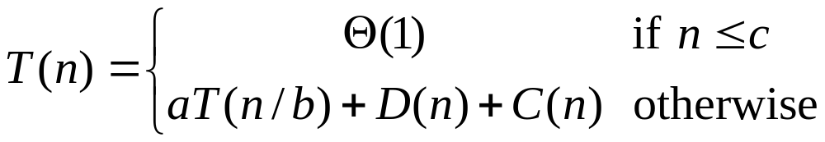
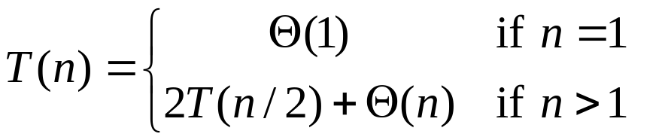
Analysis of Merge sort
Analyzing divide-and-conquer algorithms
  See Chapter 4.
Analysis of merge sort
  T(n) = Θ(nlogn)

Slide 28
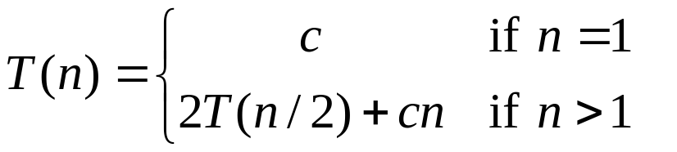
Analysis of Merge sort
where the constant c represents the time require to solve problem of size 1 as well as the time per array element of the divide and combine steps.

Slide 29
The construction of a recursion tree
T(n)
(a)
cn
cn
cn
c(n/2)
c(n/2)
cn
T(n/2)
T(n/2)
lg n
(b)
c(n/4)
c(n/4)
c(n/4)
c(n/4)
cn
cn
c
c
c
c
c
c
c
c
cn
c(n/2)
c(n/2)
n
Total: cn lg n + cn
T(n/4)
T(n/4)
T(n/4)
T(n/4)
(d)
(c)

Slide 30
Outperforms insertion sort!

